Slide 1



Obama Urges FCC to Take Controversial Approach to Net Neutrality
CS10 The Beauty and Joy of Computing Lecture #20
Pyhton II
2014-11-12
UC Berkeley EECS Lecturer Gerald Friedland
http://www.pcmag.com/article2/0,2817,2471914,00.asp

Slide 2
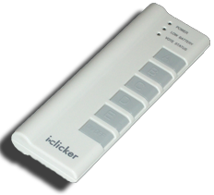
Peer Instruction
How’s your Python experience so far?
I’d rather stay with Snap!
Neutral
I love Python!
Not sure yet.
Notes:
Answer: D (includes everything in which the computer poses a question and you have to answer in a computer-readable form, which so far means multiple choice)

Slide 3
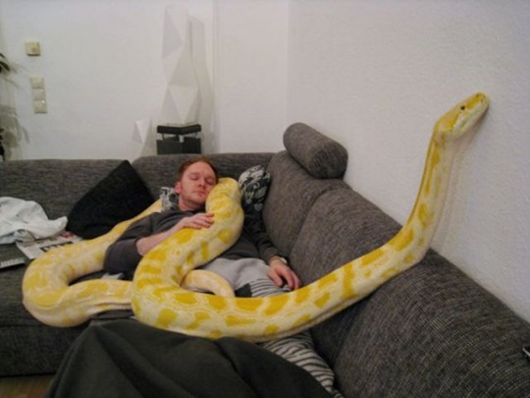
Python II: Let’s get comfortable…
http://www.thechobble.com/2012/06/ meet-julius-huge-yellow-pet-python-18.html

Slide 4

Python II
Defining a function
List and dictionaries
HOFs in Python
APIs
A game in Python

Slide 5
Defining a Function
A function/method/procedure/block
is defined with def
def function1():
print “Hello World”
def function2(parameter1, paramter2):
print parameter1+parameter2

Slide 6
Defining a Function
Remember this?
def fib(n):
a,b=0,1
while a < n:
print(a)
a,b=b, a+b
Let’s give it a try…

Slide 7
Iterators
For iterates over lists
list = [2, 4, 6, 8]
sum = 0
for num in list:
sum = sum + num
print("The sum is:", sum)
Let’s give it a try…

Slide 8
How to iterate over a range…
…with range:
list = range(1,10)
sum = 0
for num in list:
sum = sum + num
print("The sum is:", sum)
Let’s give it a try…

Slide 9
Speaking of list…
Lists can contain anything
list = [1,2,3]
list = [“Hello”,”World”]
list = [“Hello”,1,”World”,2.3]
list = [[1,2],[3,4],[5,6]]
list = [(1,2),[3,4],5,6]
Let’s give it a try…

Slide 10
List Comprehension
How to work with Lists
list = range(1,5)+range(5,10)
elem = list[3]
elems = list[3:5]
list2 = list[4:]
list3 = list[:9]
Let’s give it a try…

Slide 11
List Comprehension (more)
How to work with Lists
fruits = ['Banana', 'Apple', 'Lime']
loud_fruits = [fruit.upper() for fruit in fruits]
list(enumerate(fruits))
Let’s give it a try…

Slide 12
List Comprehension (more)
How to work with Lists
List=[0,1,2,3,4,5,6,7,8,9]
list.reverse()
list.sort()
list.count(10)
list.insert(5,123)
Let’s give it a try…

Slide 13
Dictionaries
stuff = {'name': 'Zed', 'age': 39, 'height': 6 * 12 + 2}
print stuff[‘name’]
Let’s give it a try…

Slide 14
HOFs
HOFs are part of Python too!
map(upper, ['sentence', 'fragment'])
def is_even(x):
return (x % 2) == 0
filter(is_even, range(10))
Let’s give it a try…

Slide 15
APIs
APIs = Application Programming Interface
APIs allow blackbox use of pre-programmed elements
Provide abstraction, save work
import pygame
pygame.init()
Let’s give it a try…

Slide 16

A Game!
Python very productive language
Pacman game in under 1000 lines of code.
Works platform independent (Linux, MacOS X, Windows, iOS, etc…)
Let’s give it a try…

